Slide 1
Can the Climate afford Europe’s Gas Addiction?
Friends of the Earth Europe

Slide 2
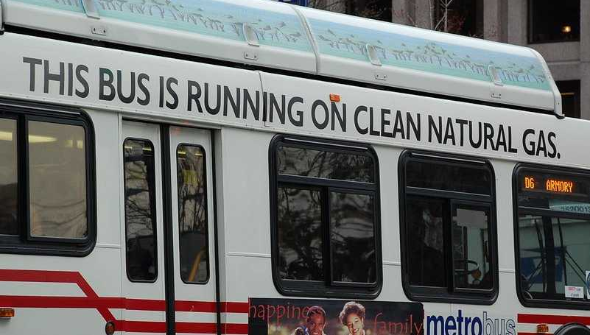
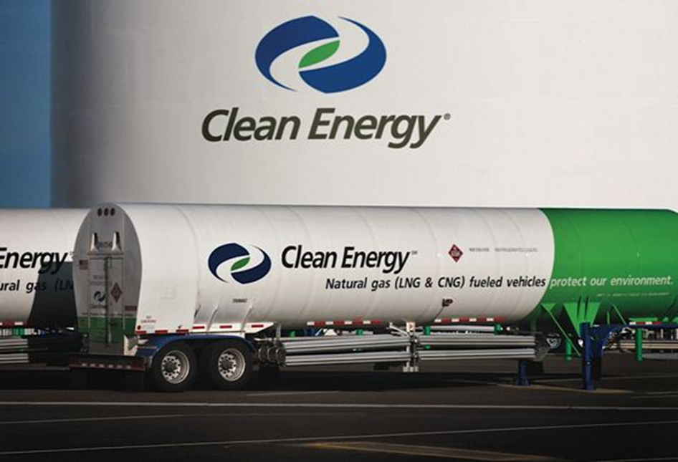
A global PR campaign to brand gas as clean

Slide 3
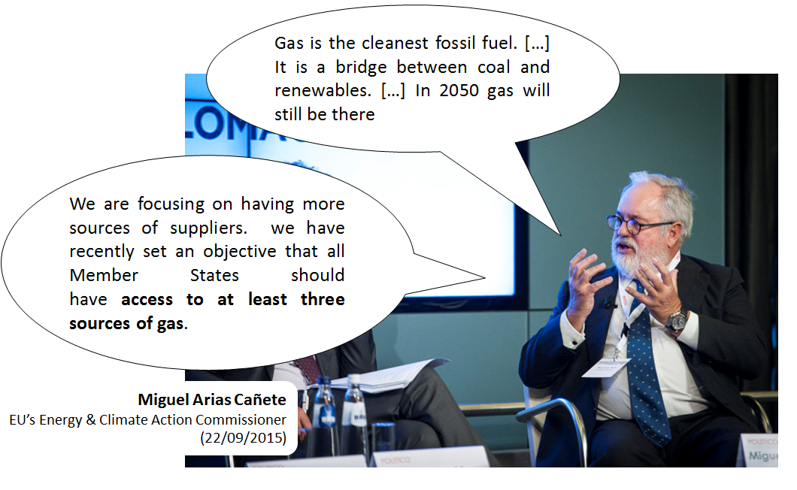
Political outreach…

Slide 4
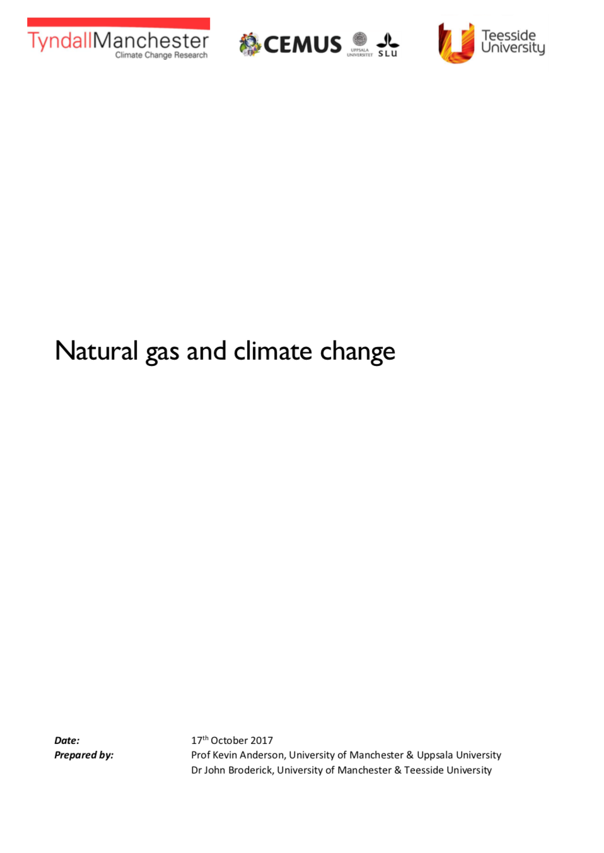
New Anderson et at study
Is gas really clean?
Can gas be a bridge fuel?
Can EU’s gas consumption compatible with staying below 2°C?

Slide 5
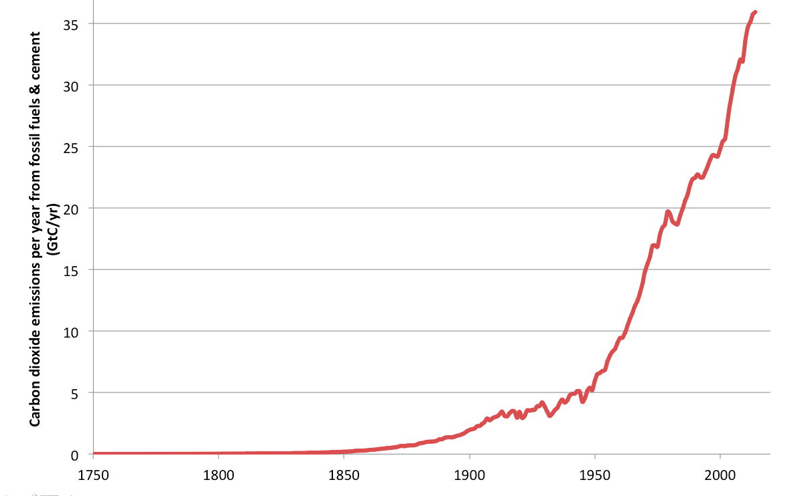
Paris Agreement
The mitigation message has changed little in twenty seven years
Annual emissions this year will be ~60% higher than in 1990
Global CO2 emissions set to rise 2% in 2017 after three-year ‘plateau’

Slide 6
Paris Agreement
Yet, Paris Agreement in 2015:
Parties committed to ‘holding the increase in the global average temperature to well below 2°C above pre-industrial levels and pursuing efforts to limit the temperature increase to 1.5°C above pre-industrial temperatures’

Slide 7
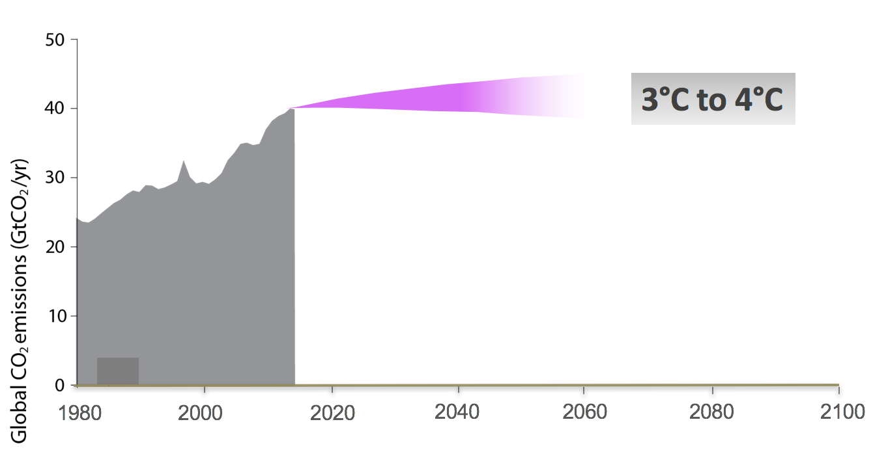
With Paris, pledges add up to…
Source: UNEP

Slide 8
For temperature (2°C)
…it’s not long-term targets (2030, 2050, etc.) that matter
Carbon dioxide emissions

Slide 9
but the carbon budget i.e. the area under the curve
Carbon dioxide emissions (GtCO2/yr)
The Carbon Budget
.

Slide 10
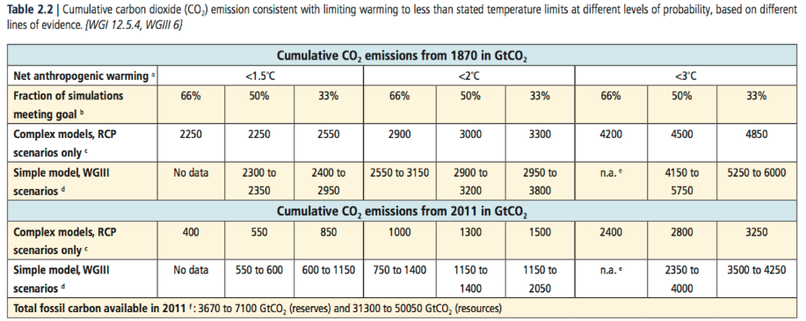
IPCC Carbon budgets: 1000GtCO2 for 2°C

Slide 11
And the Global Carbon Budget is Fast Running Out

Slide 12
Europe’s carbon budget: Anderson & Broderick
Based on:
Stringent mitigation scenarios and budgets for non-OECD nation (peak emissions between 2021 & 2025)
Three estimates of Europe’s share of the OECD carbon budget (grandfathering, population, GDP)
= EU’s carbon budget of 23 and 32 billion tonnes of CO2

Slide 13
To meet Paris Commitments
Assuming:
the EU is to meet its Paris 2°C commitment
its policies are to have a scientific foundation
makes some allowance for equity
… then,
mitigate at >12 to 16% p.a. starting now
~75% reduction in CO2 by 2025
~fully decarbonised energy by 2035-2040

Slide 14
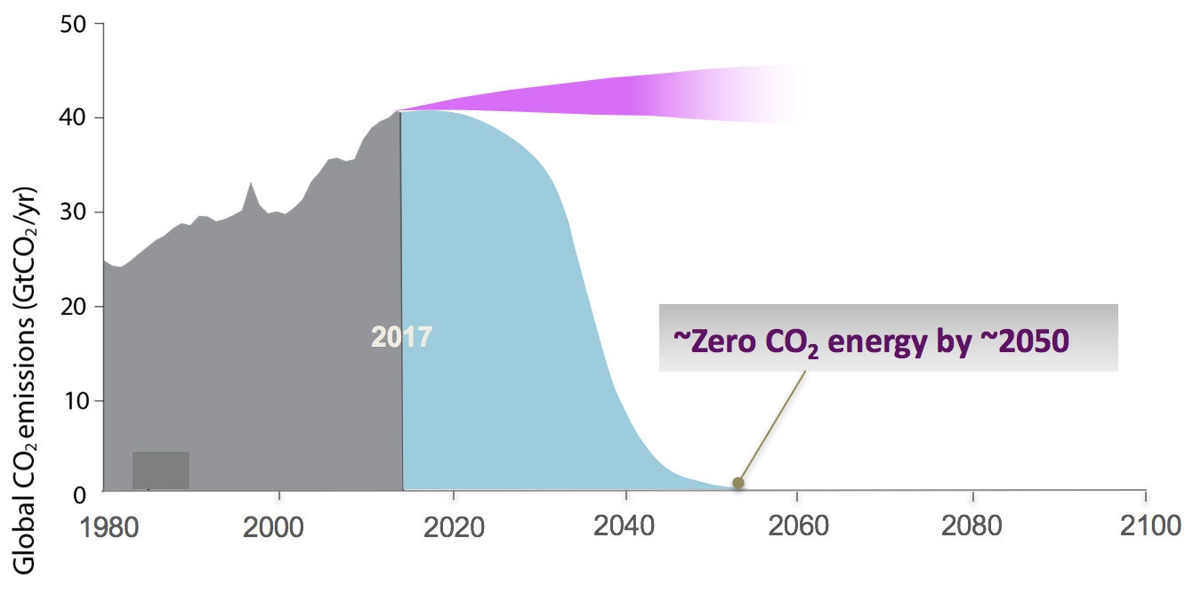
To meet Paris Commitments

Slide 15
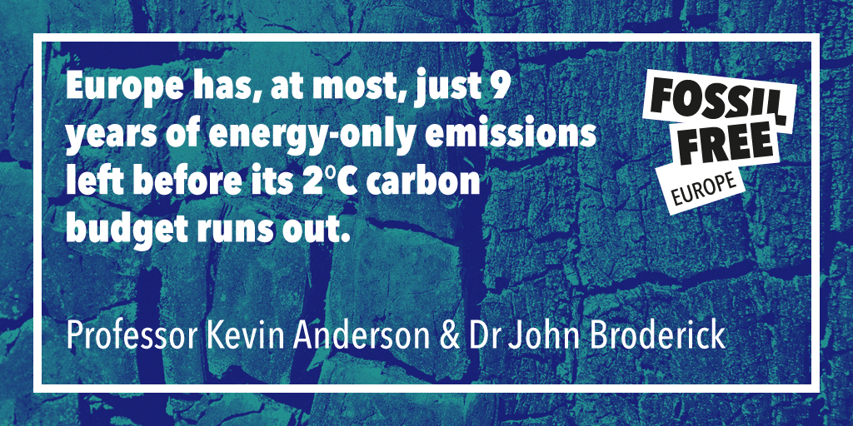
Europe’s Fair Share running out
Europe has at most just 9 years of energy-only emissions left before its 2°C budget runs out

Slide 16
Gas within the EU’s 2°C carbon budget
Gas touted as low carbon “bridging fuel” … but CH4 is 75% carbon by mass
Even if all EU oil & coal were converted to gas immediately → It would only extend EU fossil fuel use to 9 to 12 years
The “bridging” role does not stand anymore

Slide 17
Gas’s methane problem
Fossil gas is methane (CH4)
Methane is a dangerous greenhouse gas - 86x CO2 (20 years)
Though more short-lived in the atmosphere – 12 years
And gas leaks – all along the production and distribution system

Slide 18
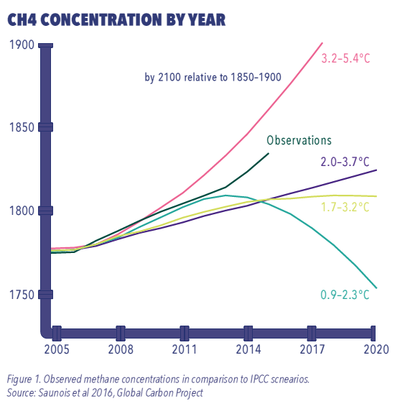
Gas concentrations going up

Slide 19
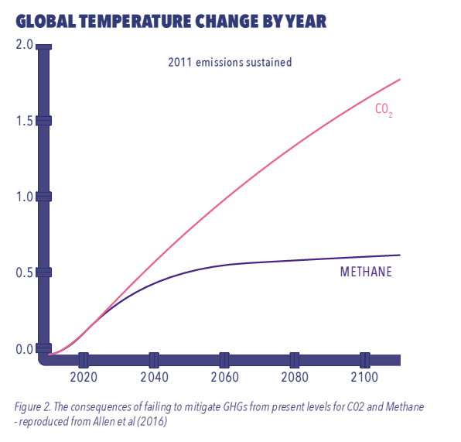
Significant impact in terms of climate change

Slide 20
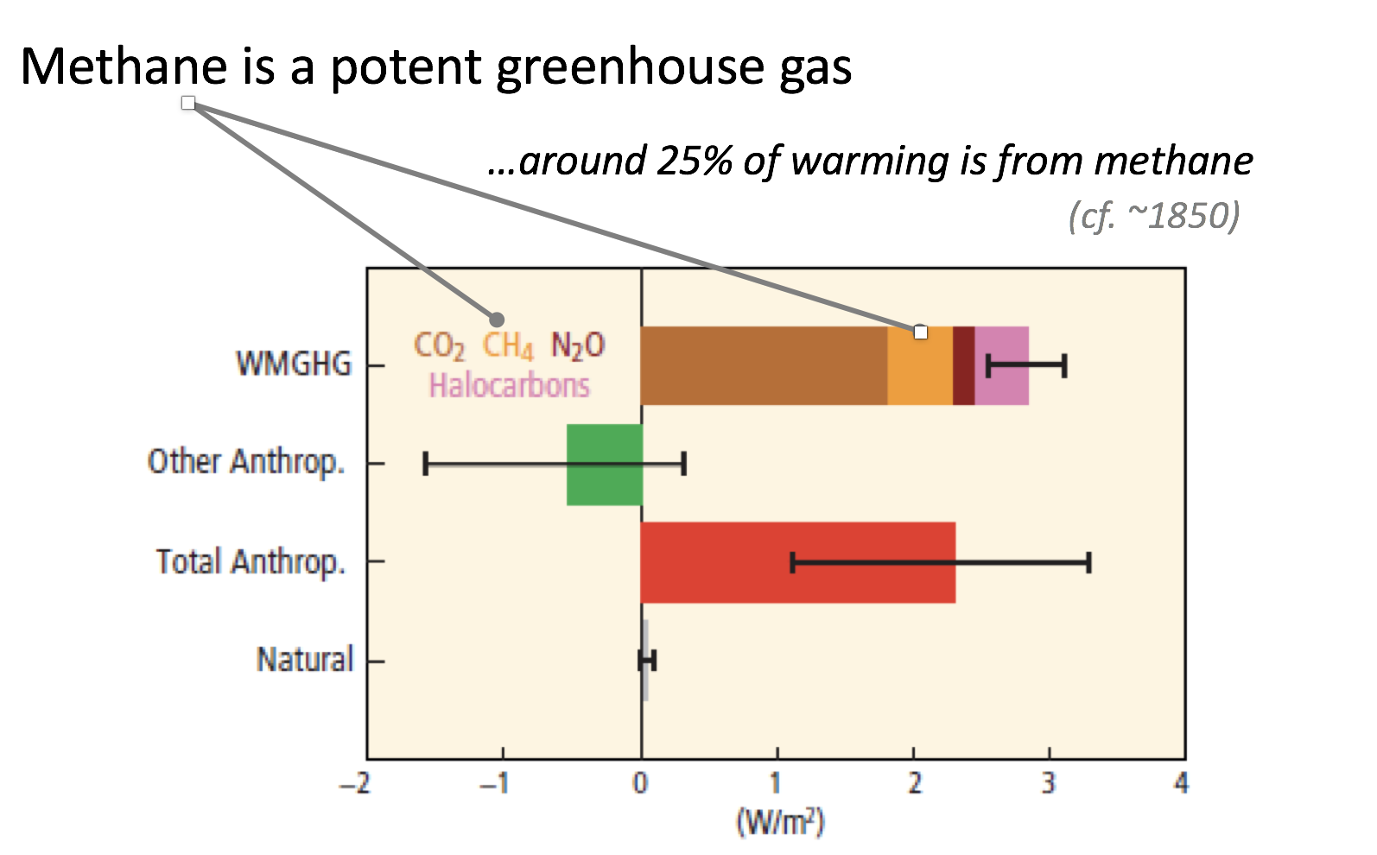
Gas & the implications of METHANE emissions

Slide 21
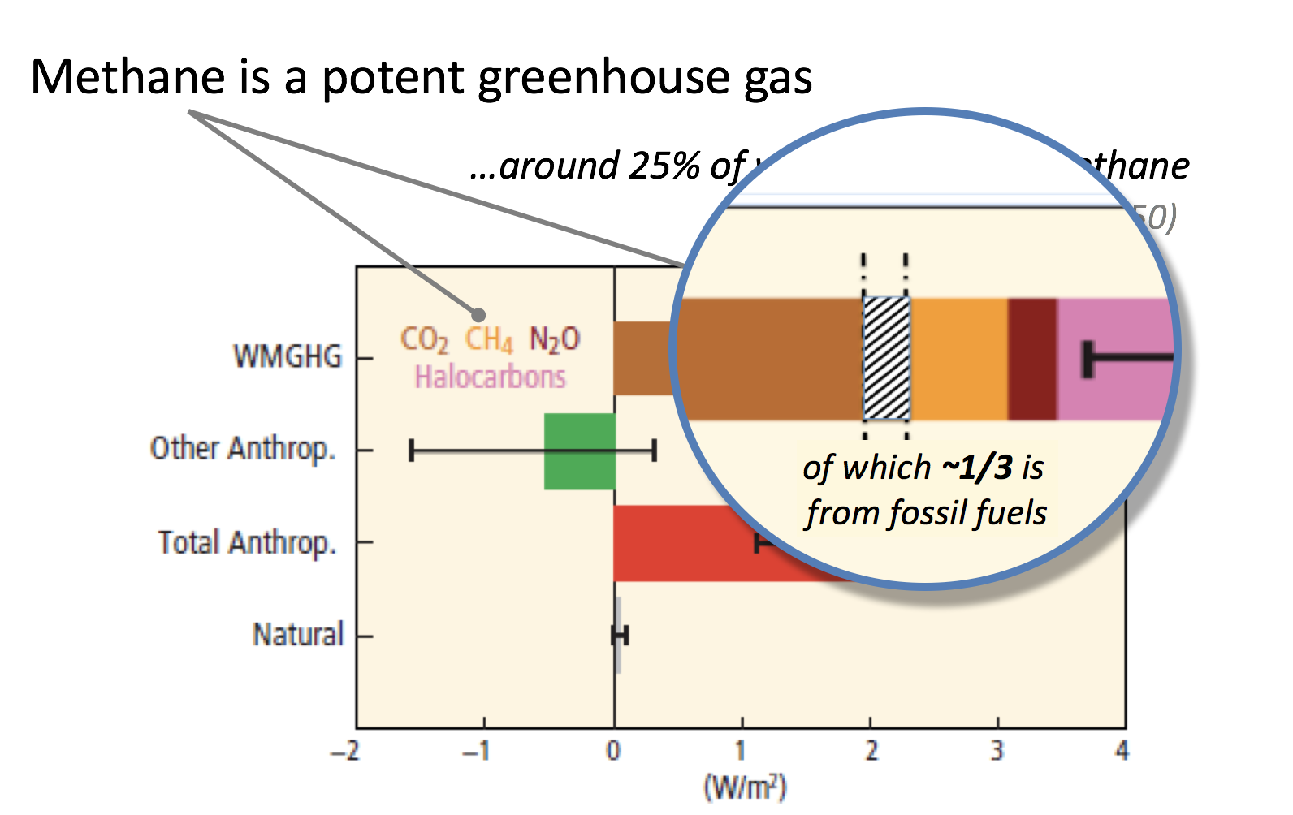
Gas & the implications of METHANE emissions

Slide 22
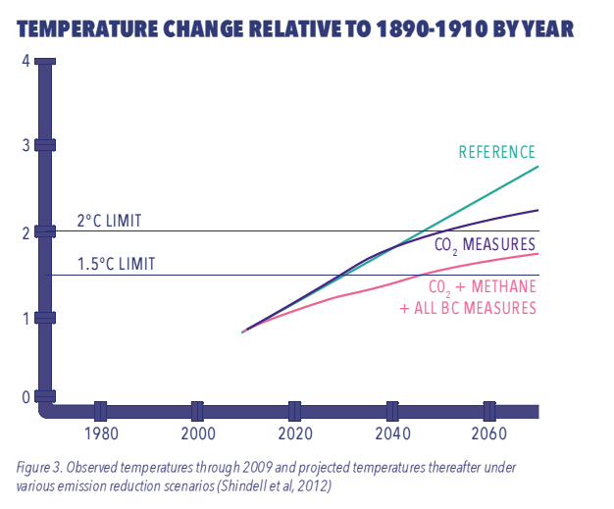
Necessity to combine reduction of CO2 and methane emissions

Slide 23
Conclusion
Remember: Gas (methane) is a “high-carbon” energy source
Methane leaks are important contributors to current & future warming
Unchanged methane emissions add a 0.6°C of warming
Rising methane will increase this temperature rise
Consequently reducing methane from all sources is important
New gas supply is incompatible with the EU’s 2°C carbon budgets
Need rapid decommissioning of existing fossil fuel infrastructure
This needs to be completed within 20 years

Slide 24
Then why a new push for gas?

Slide 25
Gas: the fossil fuel industry’s last stand
Oil and gas companies now investing more in gas than oil (Total, BP etc)
Major promotional and lobby campaigns to promote gas e.g GasNaturally
Claims that gas is ‘green’ or ‘clean’ or ‘low carbon’

Slide 26
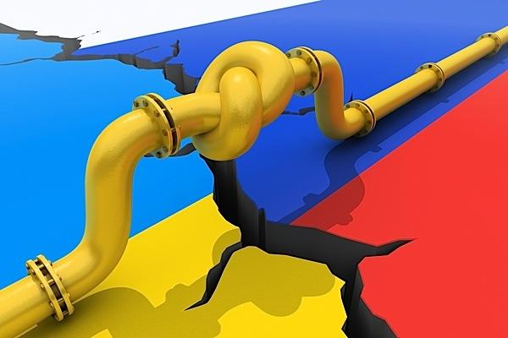
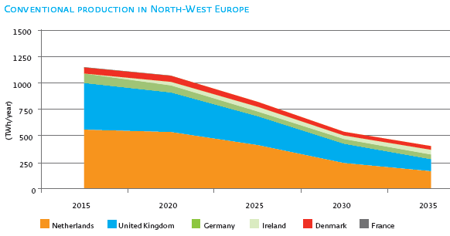
A specific geopolitical & economic context

Slide 27
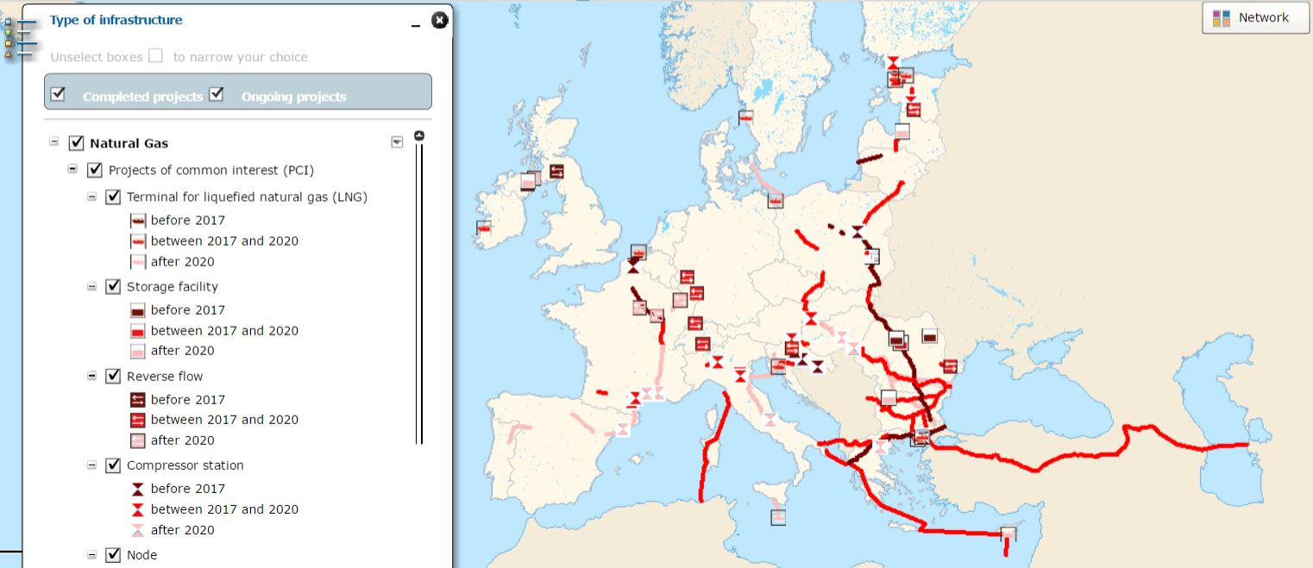
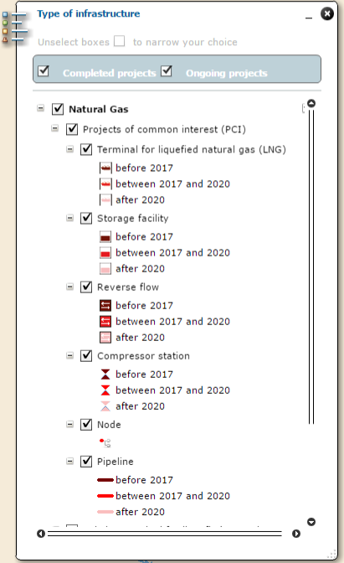
… leading to a massive support for new gas projects “The EU list of projects of common interest” (PCI List)

Slide 28
… leading to a massive support for new gas projects “The EU list of projects of common interest” (PCI List)

Slide 29
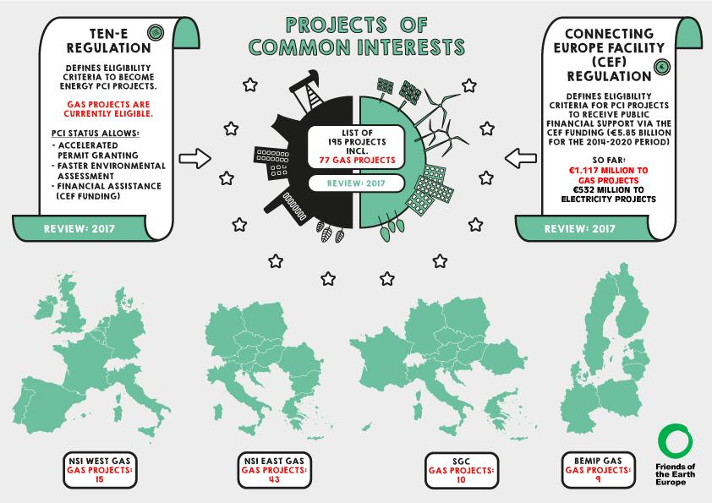
… leading to a massive support for new gas projects “The EU list of projects of common interest” (PCI List)

Slide 30
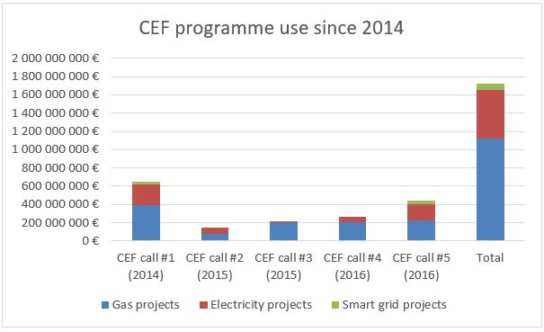
… leading to a massive support for new gas projects “The EU list of projects of common interest” (PCI List)

Slide 31
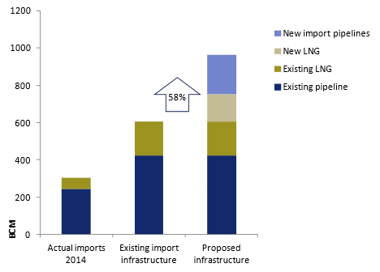
An EU gas infrastructure boom

Slide 32
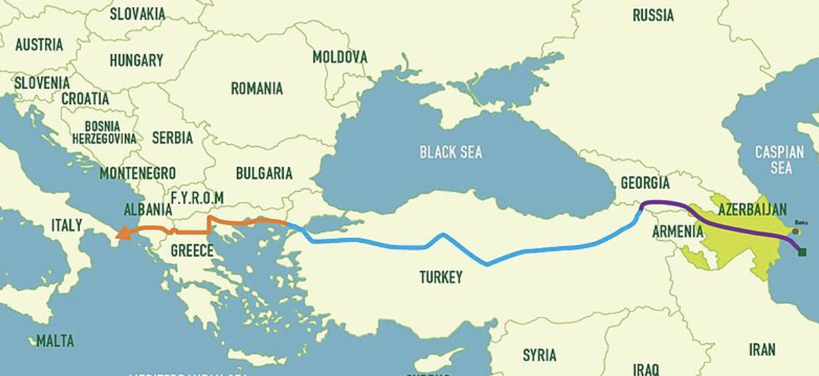
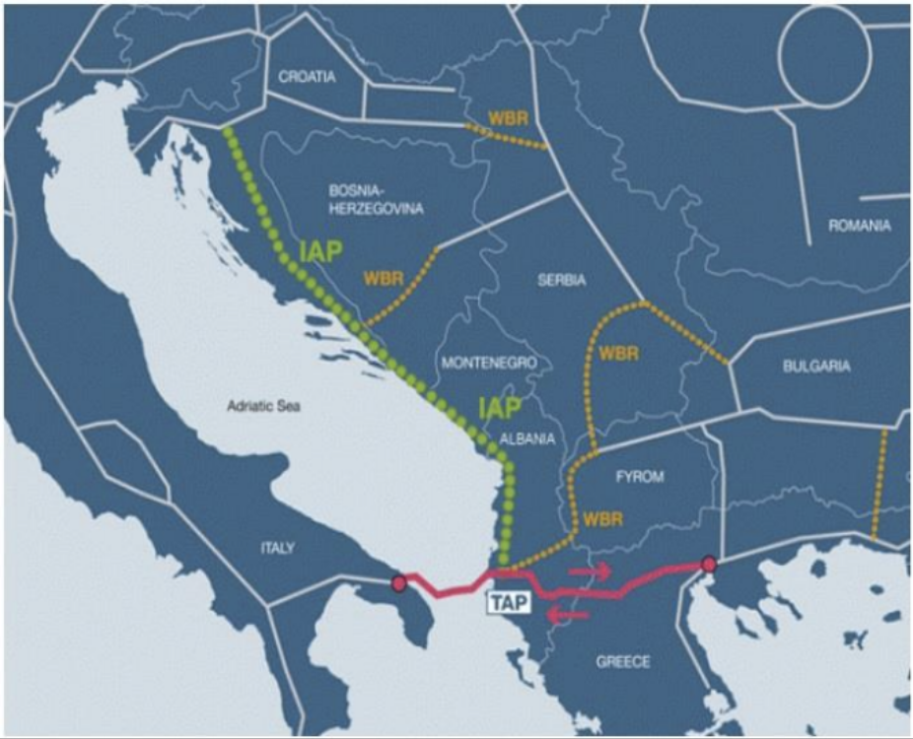
… but are they really necessary? Croatian/Slovenian example

Slide 33
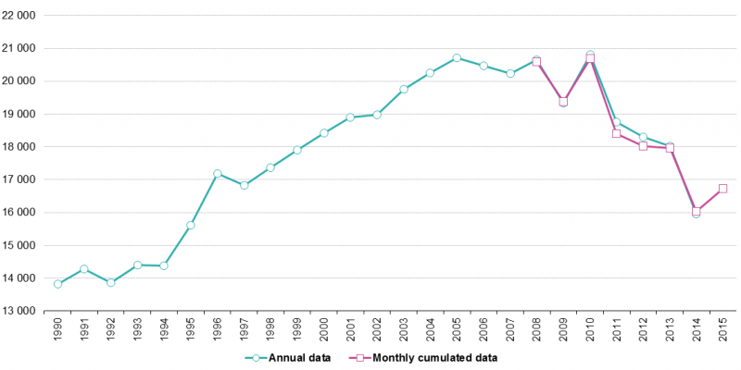
Because of gas demand? – Not so sure… A structural decline
542 bcm
- 20%
435 bcm

Slide 34
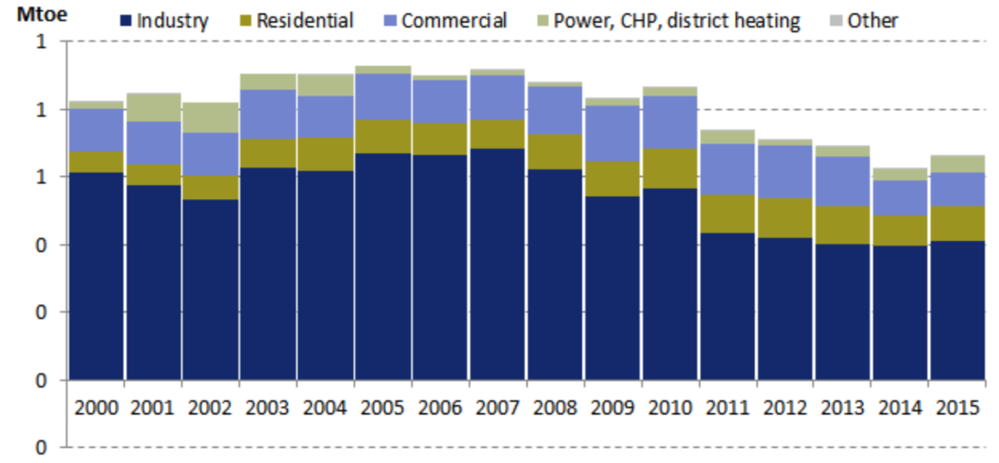
Because of gas demand? – Not so sure… Same trend in Slovenia
- 24%

Slide 35
Because of gas demand? – Not so sure… A biased assessment of future gas demand

Slide 36
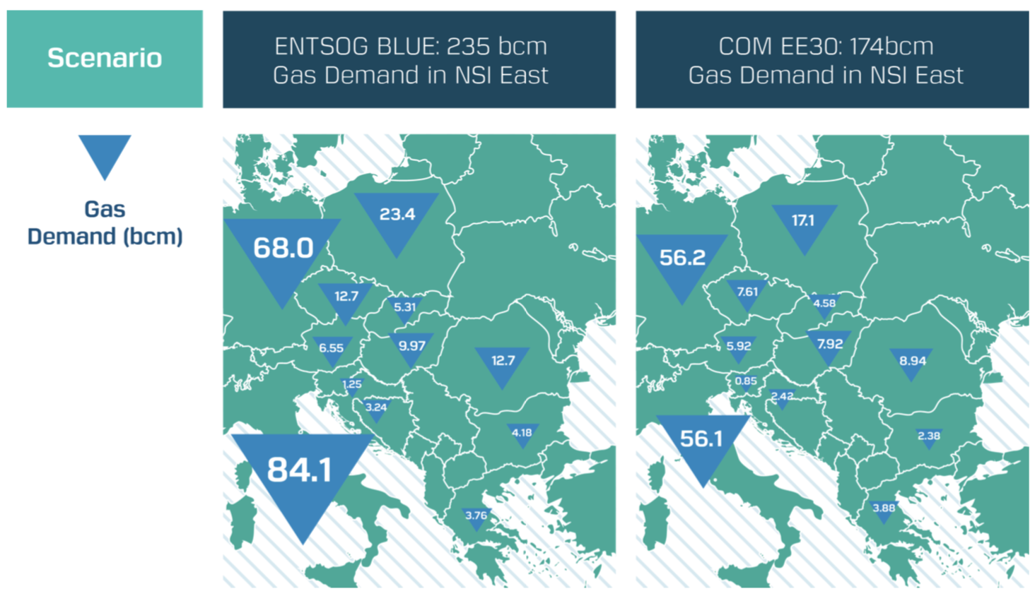
Because of gas demand? – Not so sure… A biased assessment of future gas demand

Slide 37
Because of insufficient import infrastructure – Certainly not in Slovenia
Slovenia consumes around 0.8 bcm per year
Existing interconnectors for import with Austria (3.91 bcm/y) and Italy (0.97 bcm/y) and can send 1.8 bcm/y to Croatia.
→ More than enough to meet its demand

Slide 38
Because of insufficient import infrastructure – Certainly not in Slovenia and neighbouring countries
Slovenia:
Gas demand: 0,8 bcm/y (-24% since 2010)
Can import ~4,5 bcm/y (via IT & AT)
Croatia:
Gas demand: ~2.5 bcm/y
2.6 bcm/y HR-HU, 7 bcm/y HU-HR, 1.8 bcm/y HR-SI-HR
Produces 70% of its gas needs
Austria:
Gas demand: ~8.5 bcm/y
Can import ~73 bcm/y (x9) & export 69 bcm/y
Hungary:
Gas demand: 9 bcm/y (-40% since 2005)
Can import ~27 bcm/y (via AT, SK, RO, UA)
Produces 18% of its gas needs

Slide 39
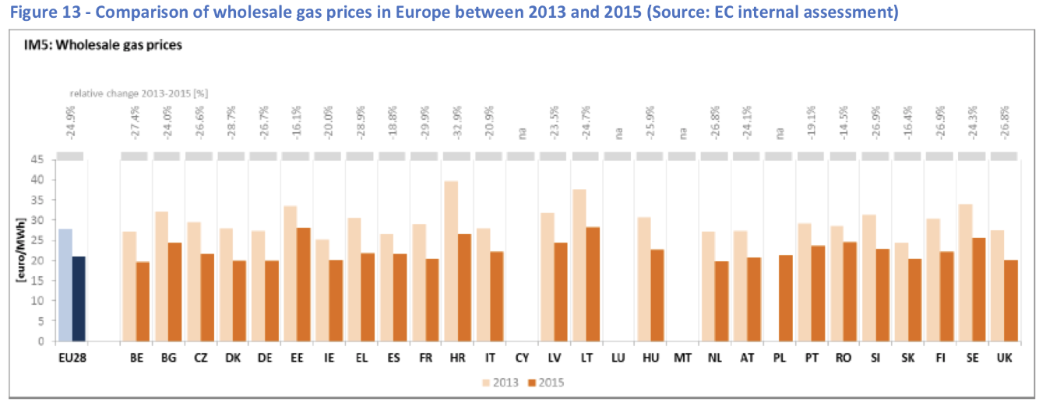
To harmonize gas prices? – Gas hub prices convergence already happening
▼ -32.9%
▼ -26.9%

Slide 40
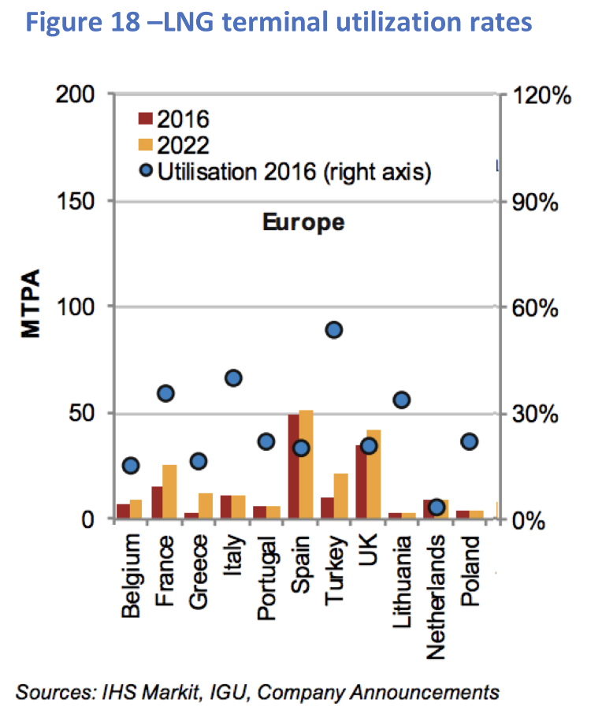
Because LNG is good and efficient and because US shale gas is cheap – No and No.

Slide 41
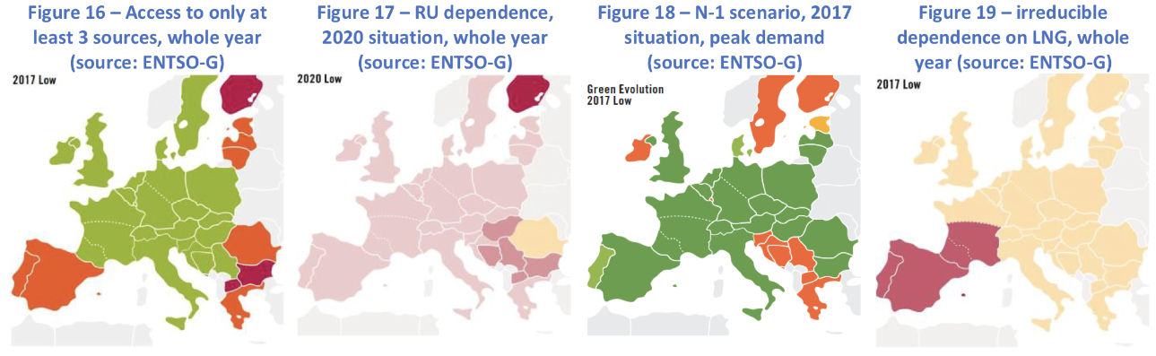
Because of energy insecurity? – Not according to industry data

Slide 42
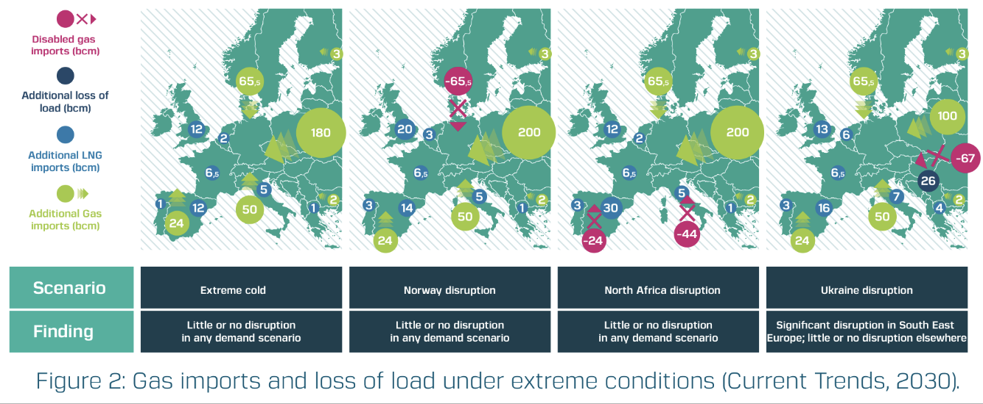
Because of energy insecurity? – A European gas system now extremely resilient…

Slide 43
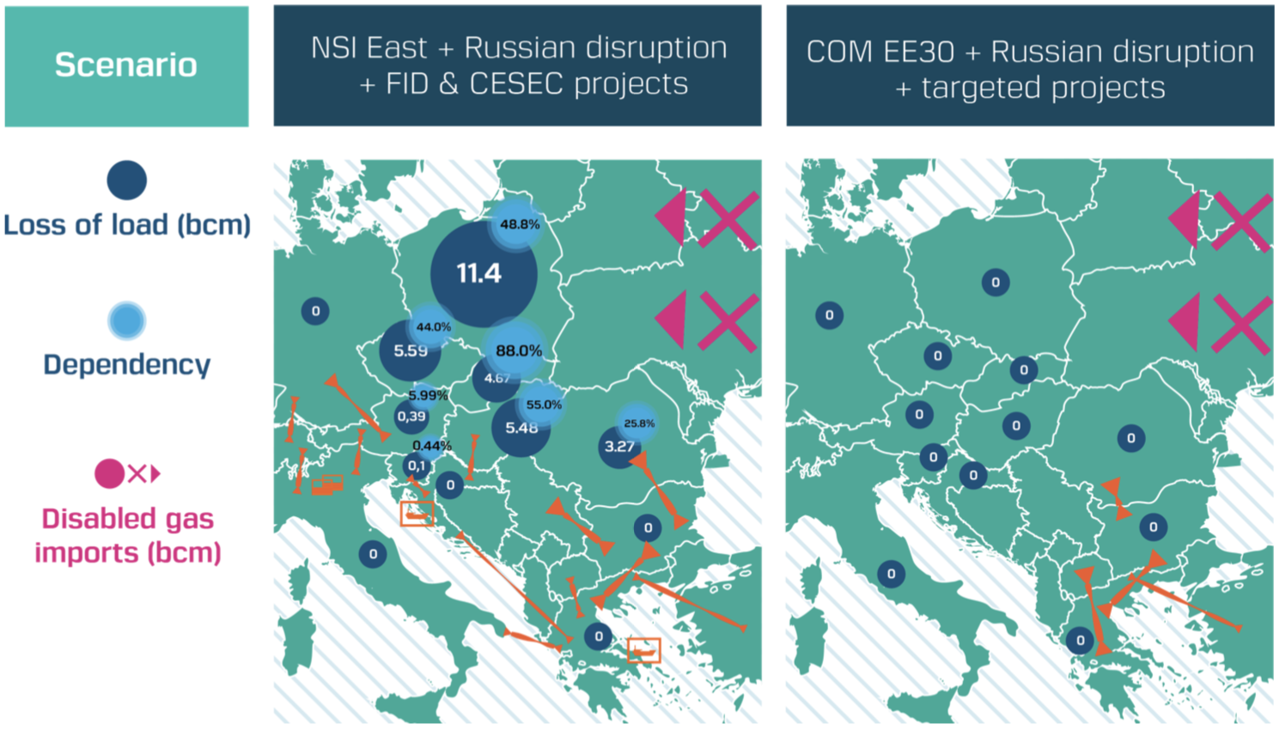
Because of energy insecurity? – … Even more resilient with EU energy efficient targets

Slide 44
Because of energy insecurity? – … Even more resilient with EU energy efficient targets
→ Useless

Slide 45
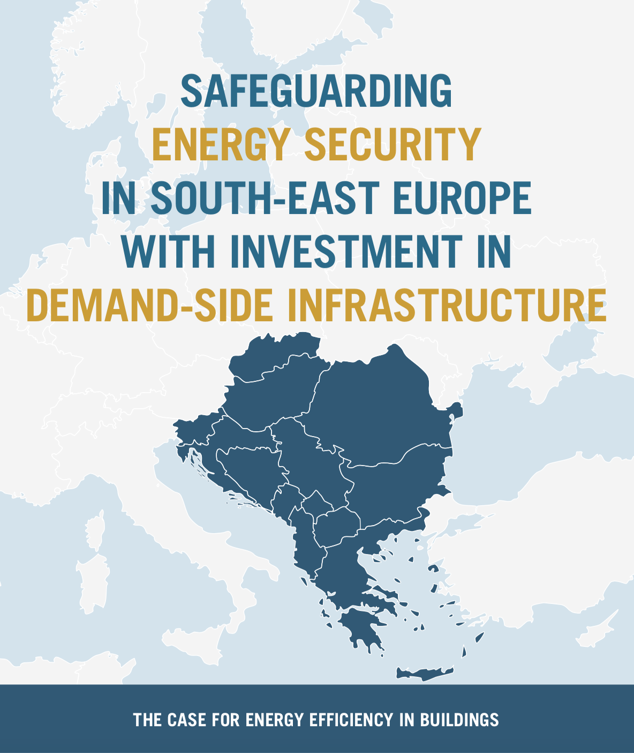
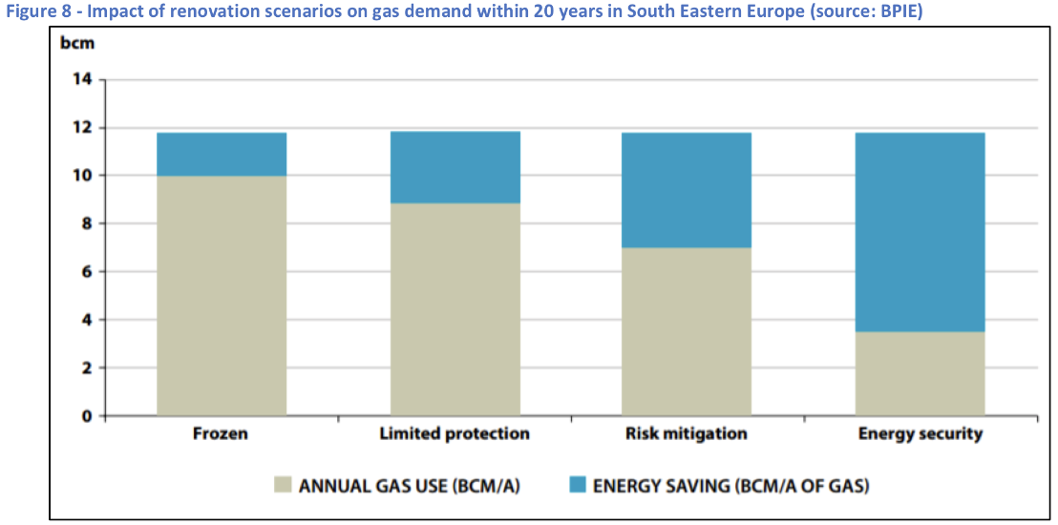
Much more potential with energy savings
- 70%

